Slide 1
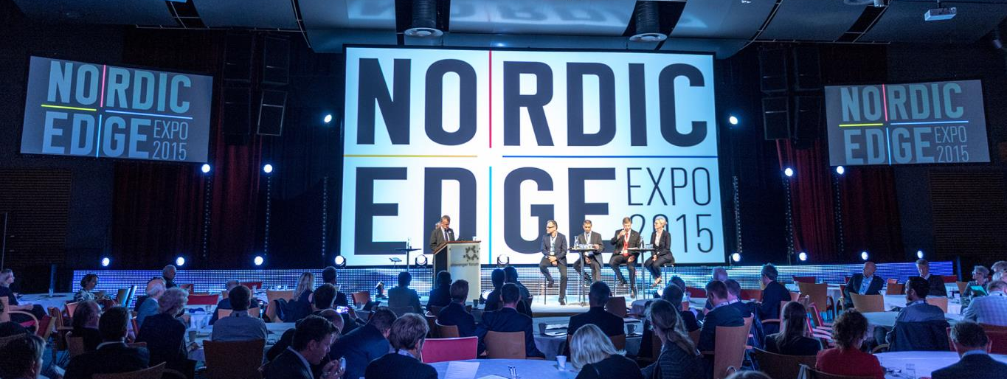
Smarter Cities & Communities
An introduction to Nordic Edge Expo

Slide 2

OUR VISION
Nordic Edge Expo will be one of Europe's most
Important meeting places for all who see the potential
for technological solutions that will make cities,
communities, industries and homes smarter.

Slide 3
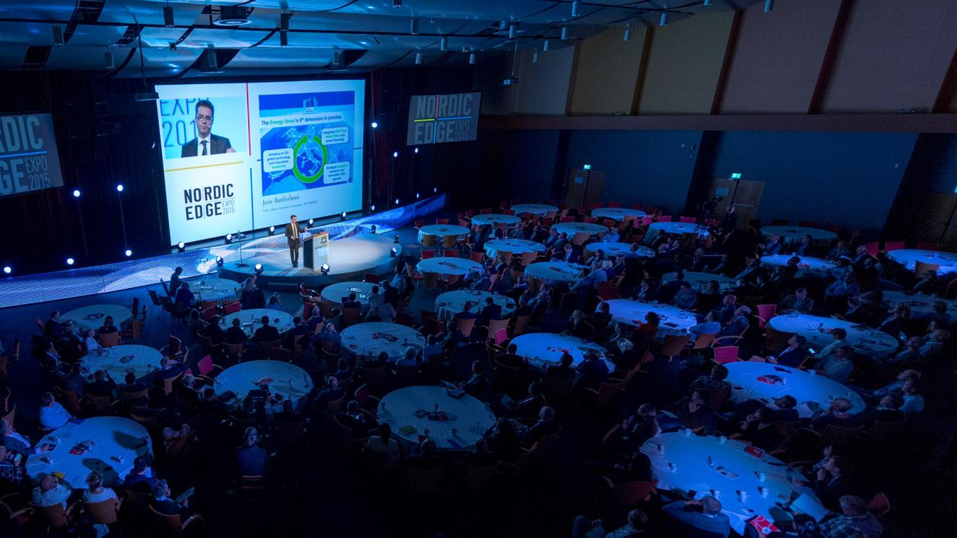

BRAND PURPOSE
Nordic Edge Expo will be a key
catalyst in building a new smart
technology-based business cluster based on the innovative spirit
of the Nordic countries

Slide 4
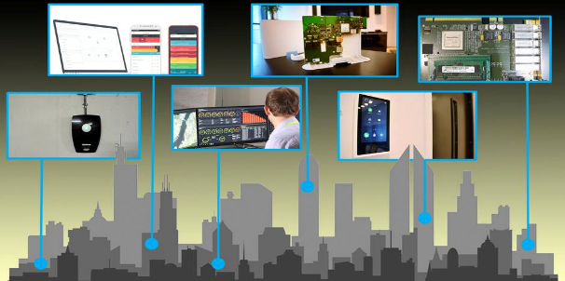
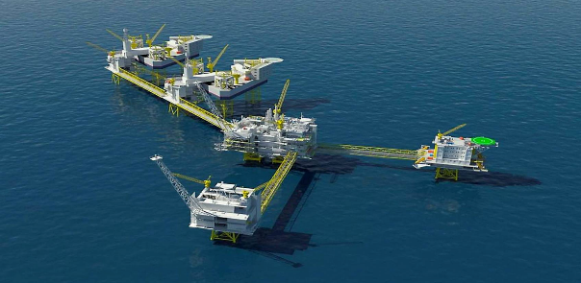
Why Stavanger?
Competence transition: Building on the technology leadership in oil & gas – moving into ‘the smart field’
One of Europe’s best fiber broadband networks,
1 gigabyte/s to all customers in 2016
Norwegian Smart Care Cluster, a welfare technology cluster with 60 partners
Triangulum, a €25 million Horizon 2020 project to demonstrate cutting-edge smart city technologies
A developing smart city cluster with members like Lyse, Future Home, Zaptec, Westcontrol and Nordic Smart Buildings and several municipalities
Political backing; City Council Smart Strategy

Slide 5
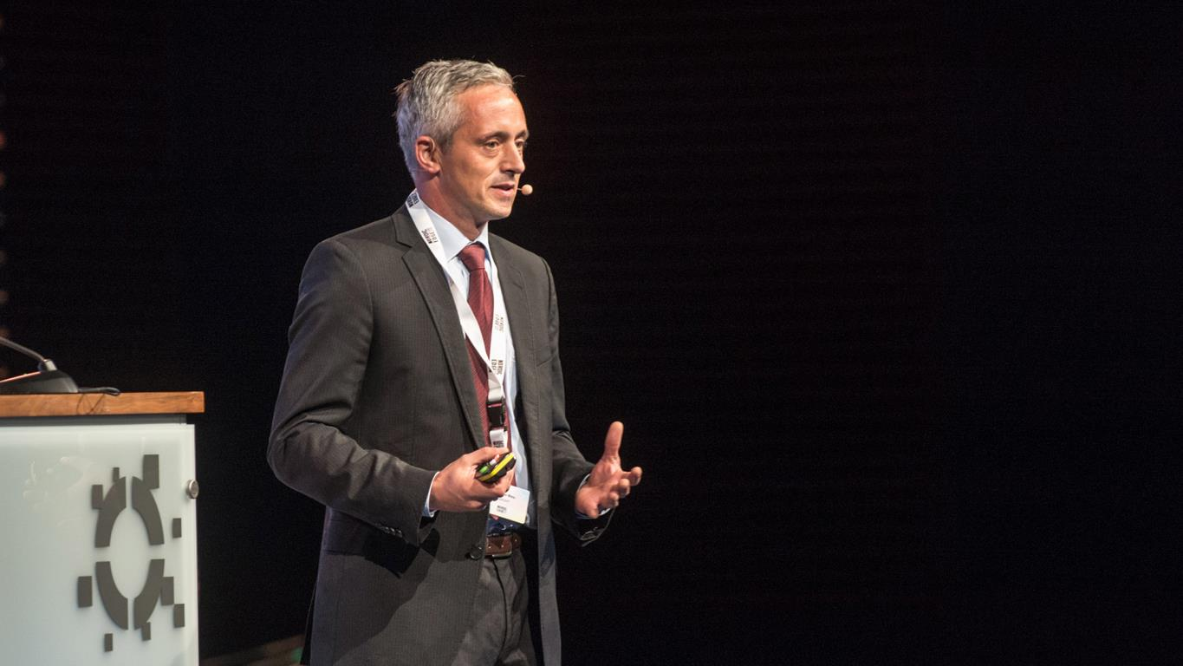
“An ideal platform to meet
interesting people and to expand
valuable networks, and very
professionally organized”
Matthias Weis
EnBW

Slide 6
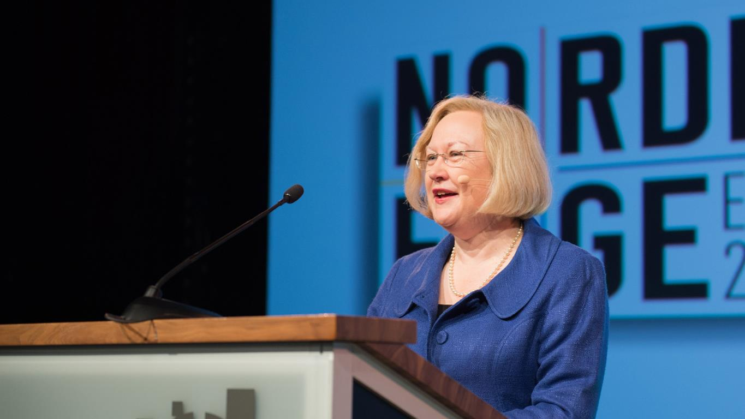
“Many congratulations on
Nordic Edge Expo. I can honestly say
it was one of the most interesting
and enjoyable conferences
I have attended.”
Helene Campbell
EU Ambassador

Slide 7
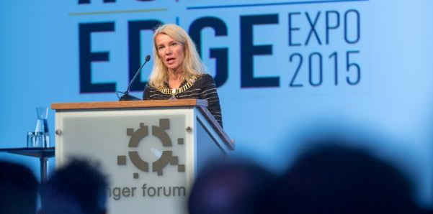
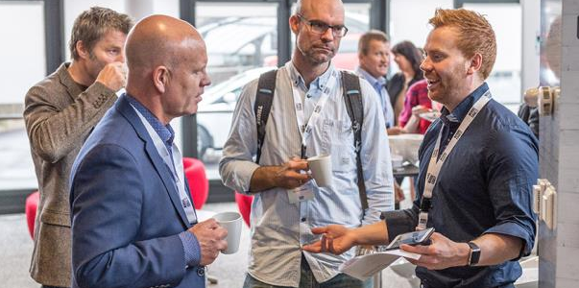
Goals and ambitions
Nordic Edge Expo shall be the indispensable annual conference and exhibition on smart technologies in Northern Europe.
The conference will gather a world-class collection of speakers from smart cities, change-making companies, start-ups, forward-thinking universities, dynamic organisations and the public sector.
The exhibition will showcase innovative smart solutions for the public sector as well as for the private sector.

Slide 8
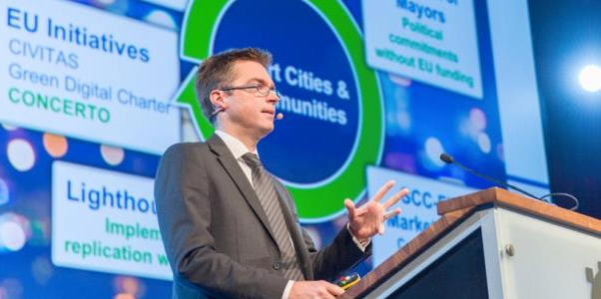
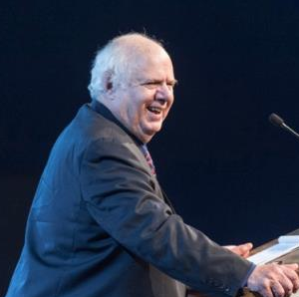
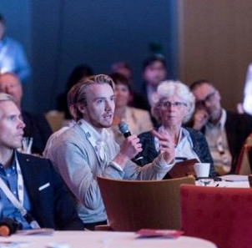
Goals and ambitions
Bridging cities and municipalities with smart technology providers.
We shall be a catalyst for growth by matching start-ups with investors and potential industrial partners.
We will apply a human-centered approach in everything we do, focusing on how we can improve people’s quality of life.
Nordic Edge shall be known for being visionary, energetic, caring and open – always on the edge of the future.

Slide 9
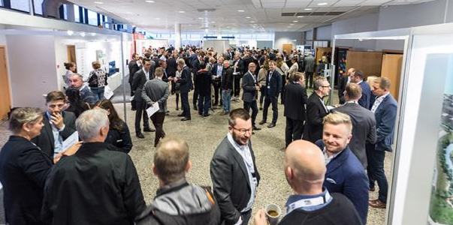
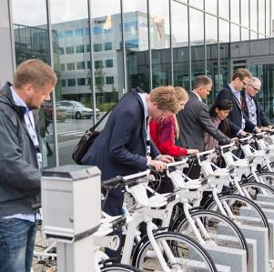
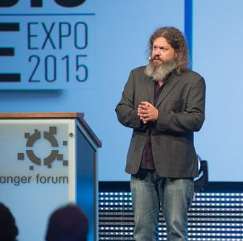
Main themes 2016
Smart City Case Studies
Smart City Management
Smart Infrastructure
Smart Care Solutions
Open data / Big Data / IoT / IoE
Green Urban Energy
Intelligent Transport Solutions
Smart Homes and Buildings
Public/Private Partnerships

Slide 10











The organisers behind Nordic Edge Expo

Slide 11












Our supporters and partners

Slide 12


WELCOME
6.-7. OCTOBER 2016

